Slide 1
Practical – 3
Machine Learning

Slide 2
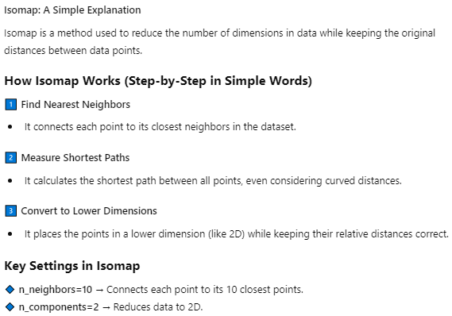
AIM:
3:- Perform Isomap to convert the data from 3D to 2D.

Slide 3



Slide 4

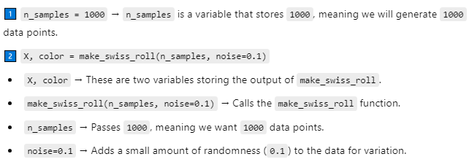


Slide 5

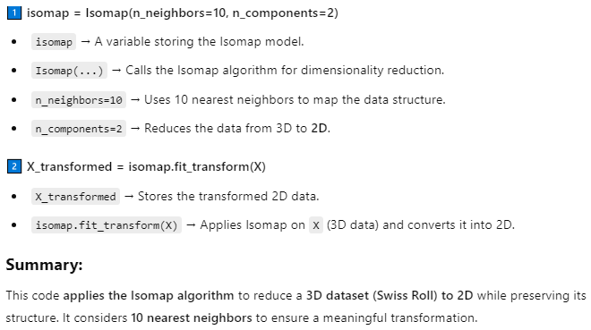

Slide 6

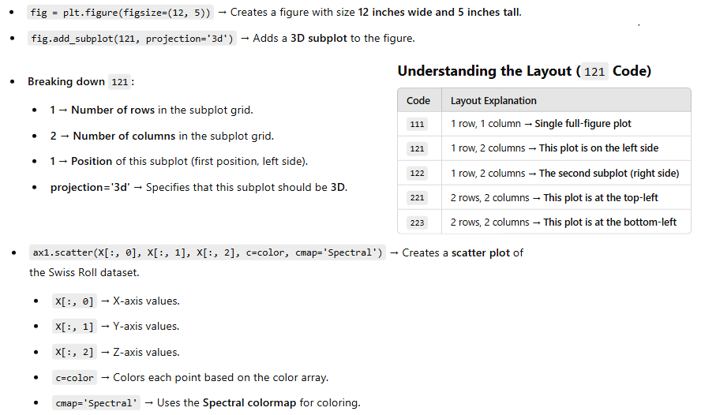


Slide 7

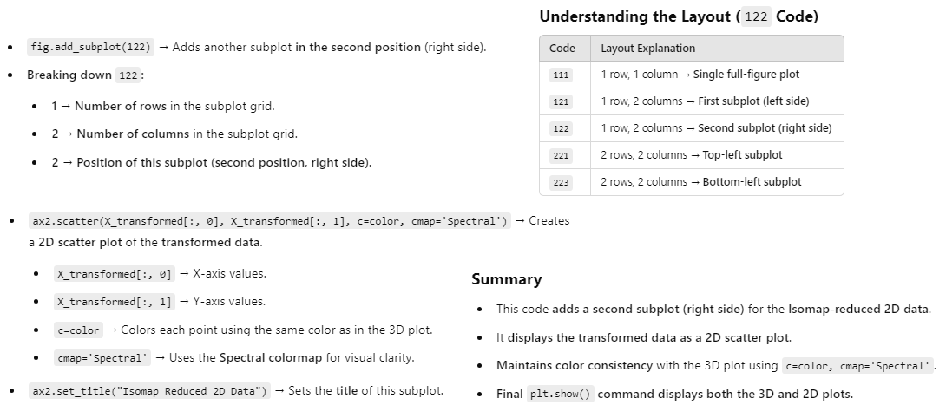

Slide 8
